Slide 1
PROJECT TITLE: Amazon Sales
Dataset Source: https://drive.google.com/file/d/1hJOXNpOUXOpyjsrBt1O8MyIJHfWgzakS/view
Working File: https://drive.google.com/file/d/1m6U7DVxAC_fkBeS9CqYhMDWKL-7txn3A/view?usp=drive_link
BY: Yash Gwalani
Digital Product Specialist | Data Analyst
LinkedIn: https://www.linkedin.com/in/gwalaniyash/
GitHub: https://github.com/DataVerse-Edge
Email: yashgwalanik@gmail.com

Slide 2
MySQL Queries
Problem Statement
Objective: Analyze the Amazon Sales database to extract and filter product information based on various criteria including pricing, discounts, ratings, and customer reviews. Execute targeted SQL queries to identify products meeting specific conditions, detect customer sentiment, and generate insights for business decision-making.
Amazon Sales Database
Query Examples & Solutions
Database: amazonsales

Slide 3
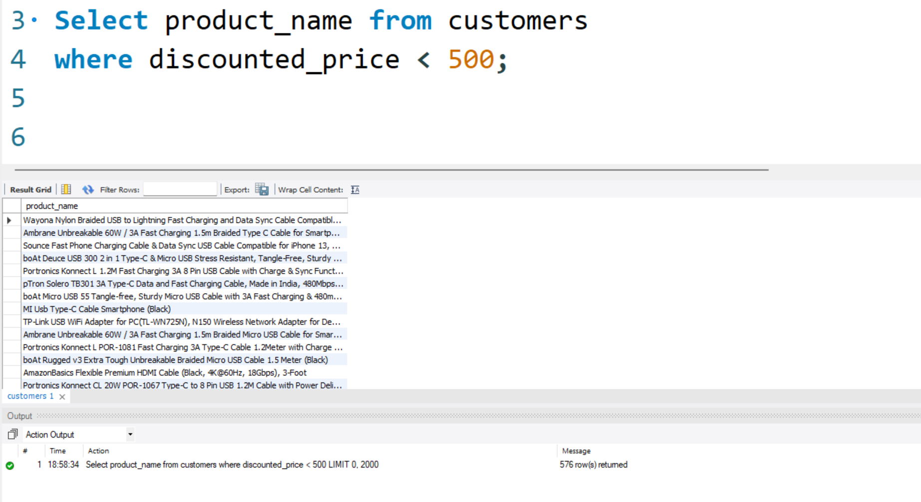
Q1: Products with Discounted Price Below ₹500
List all products with a discounted price below ₹500.
SELECT product_name FROM customers
WHERE discounted_price < 500;

Slide 4
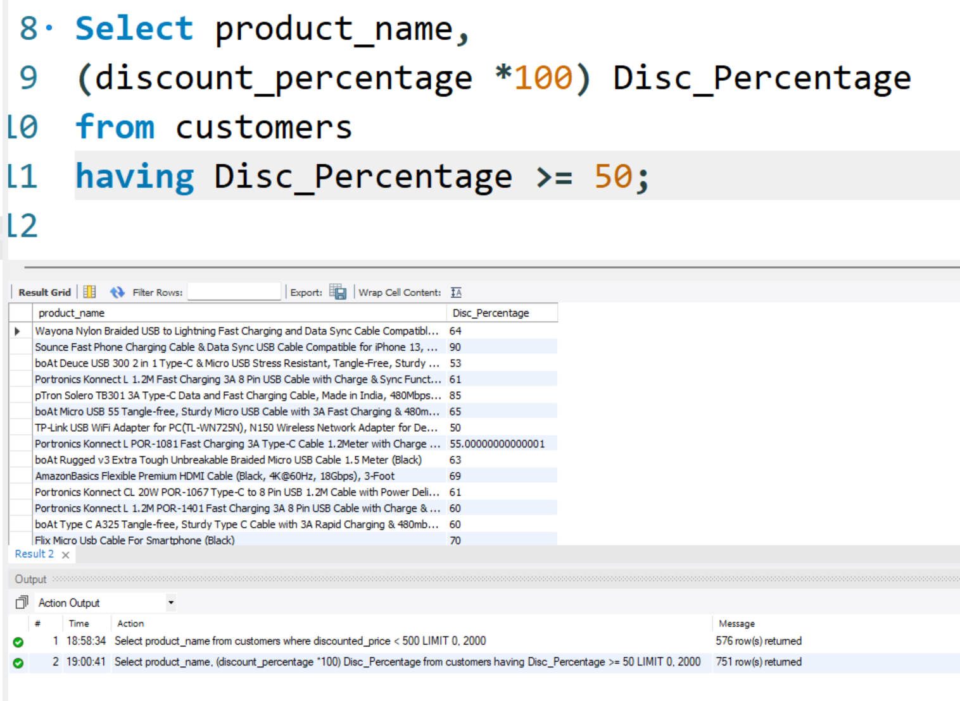
Q2: Products with 50% or More Discount
Find products with a discount percentage of 50% or more.
SELECT product_name,
(discount_percentage * 100) Disc_Percentage
FROM customers
HAVING Disc_Percentage >= 50;

Slide 5
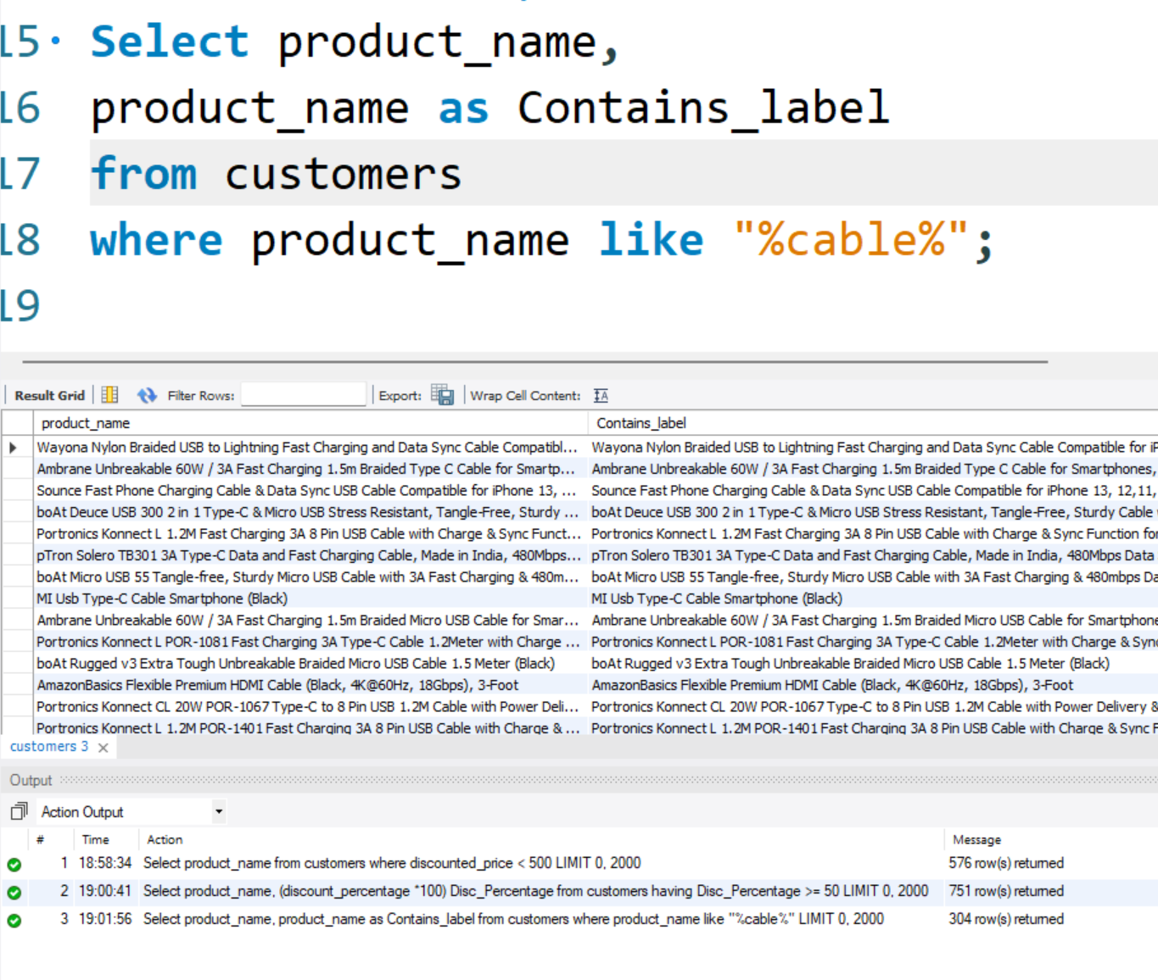
Q3: Products Containing "Cable"
Retrieve all products where the name contains the word "Cable."
SELECT product_name,
product_name as Contains_label
FROM customers
WHERE product_name LIKE '%cable%';

Slide 6
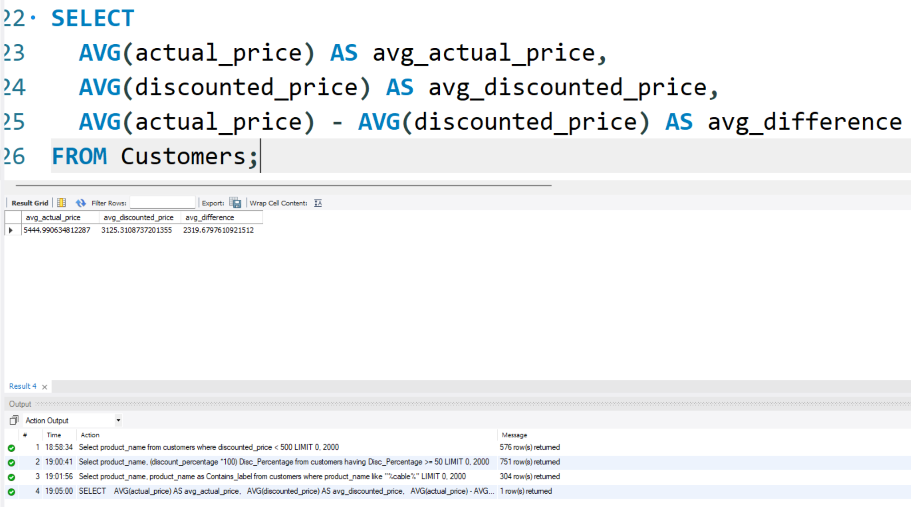
Q4: Price Difference Analysis
Display the difference between average actual price and average discounted price.
SELECT
AVG(actual_price) AS avg_actual_price,
AVG(discounted_price) AS avg_discounted_price,
AVG(actual_price) - AVG(discounted_price) AS avg_difference
FROM Customers;

Slide 7
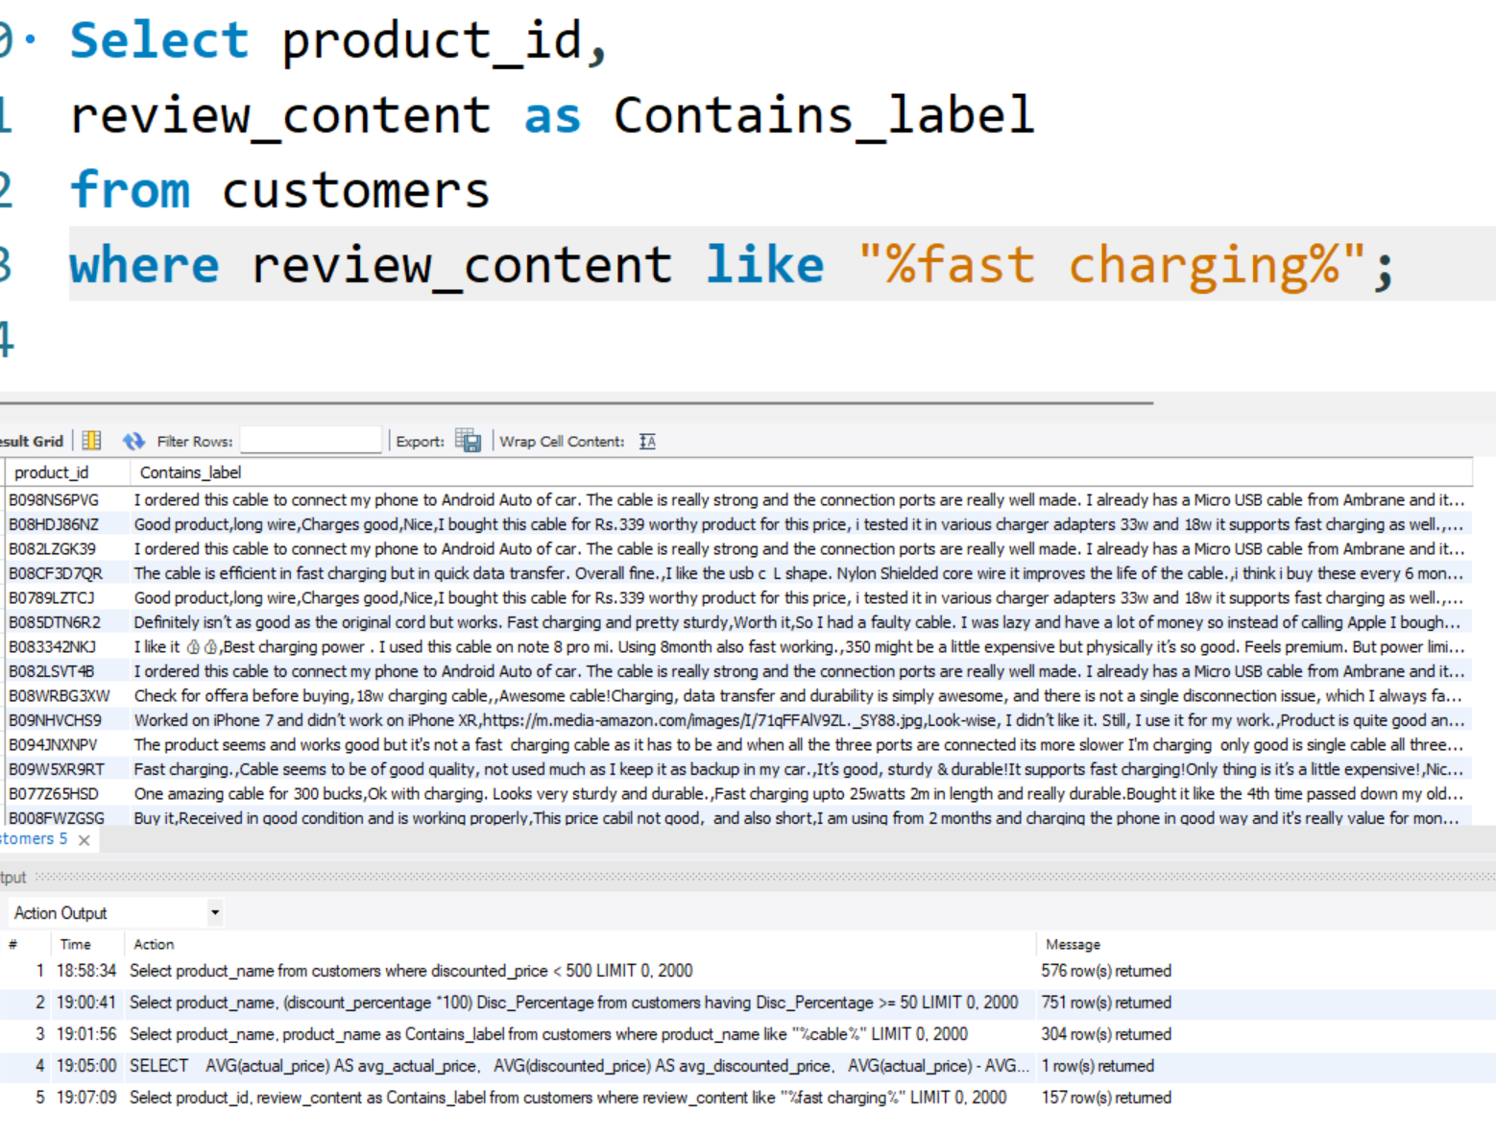
Q5: Fast Charging Reviews
Query reviews that mention "fast charging" in their content.
SELECT product_id,
review_content as Contains_label
FROM customers
WHERE review_content LIKE '%fast charging%';

Slide 8
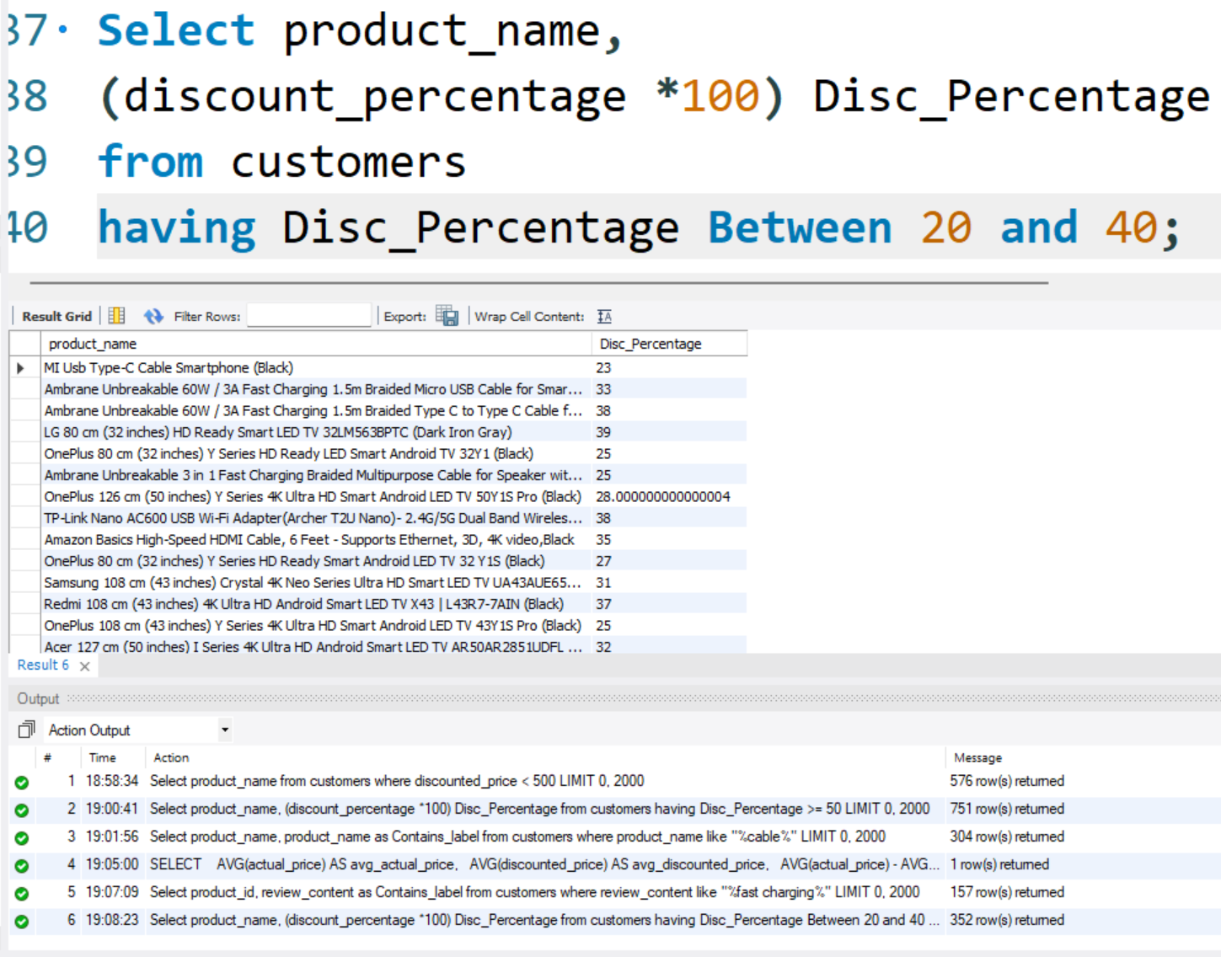
Q6: Products with 20-40% Discount
Identify products with a discount percentage between 20% and 40%.
SELECT product_name,
(discount_percentage * 100) Disc_Percentage
FROM customers
HAVING Disc_Percentage BETWEEN 20 AND 40;

Slide 9
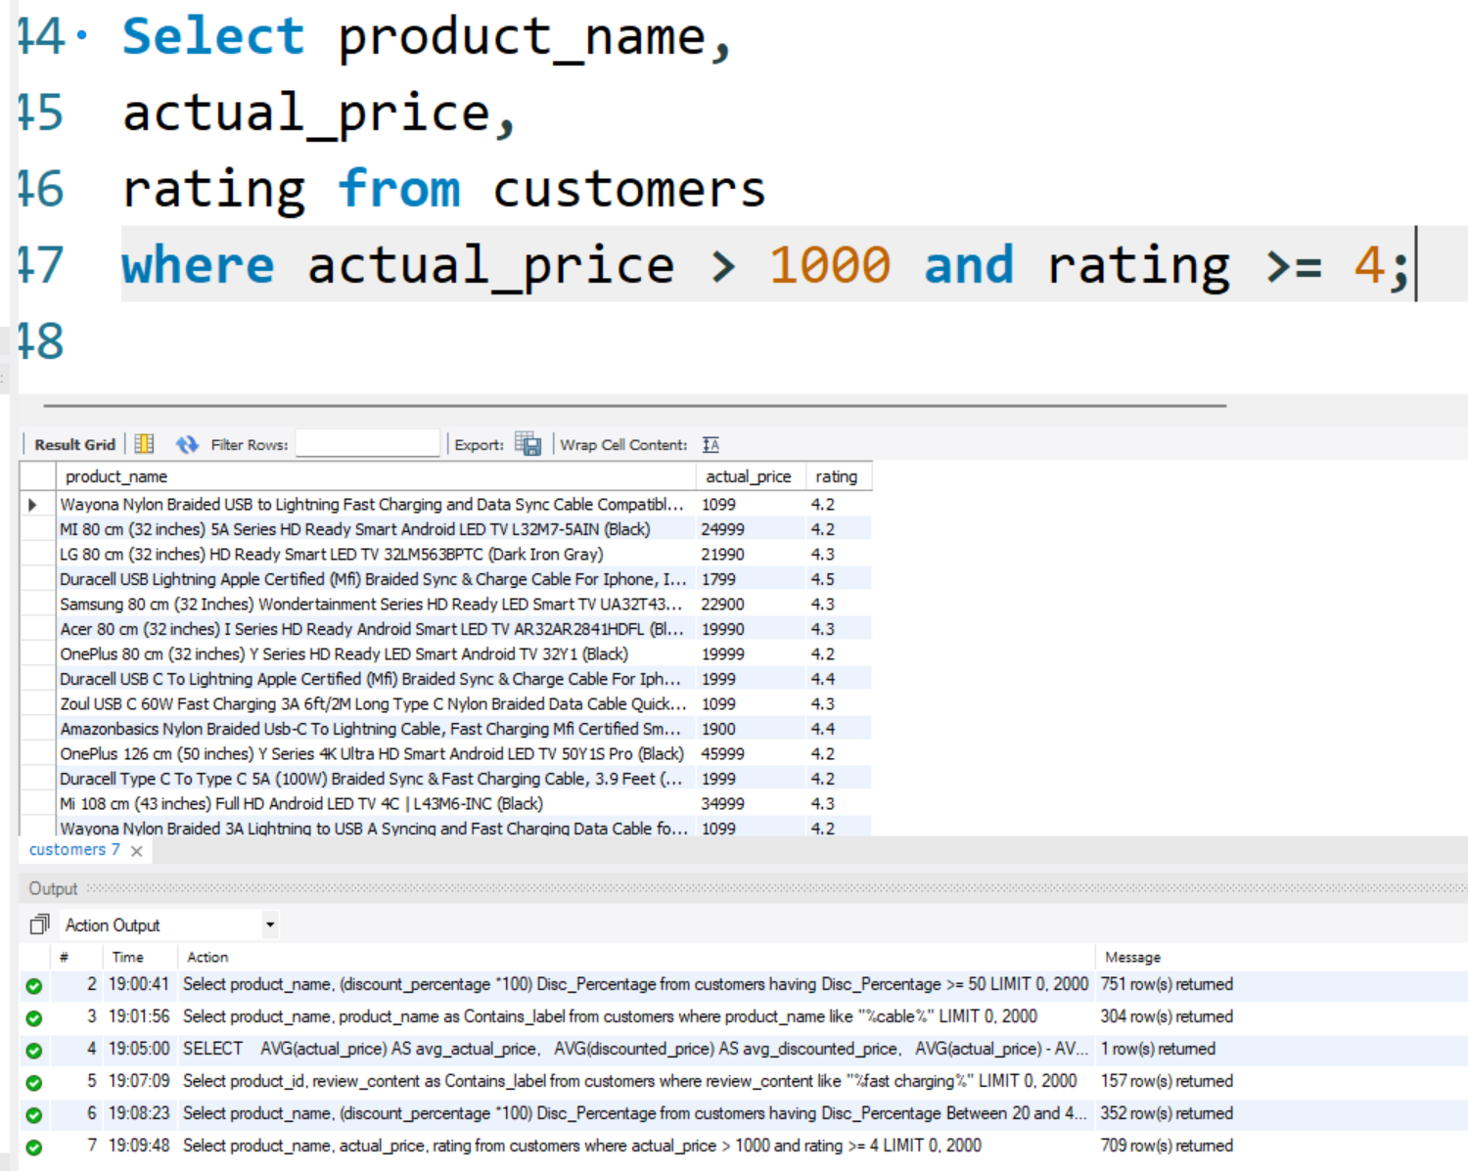
Q7: Premium Products with High Ratings
Find products above ₹1,000 with 4 stars or above rating.
SELECT product_name,
actual_price,
rating
FROM customers
WHERE actual_price > 1000 AND rating >= 4;

Slide 10
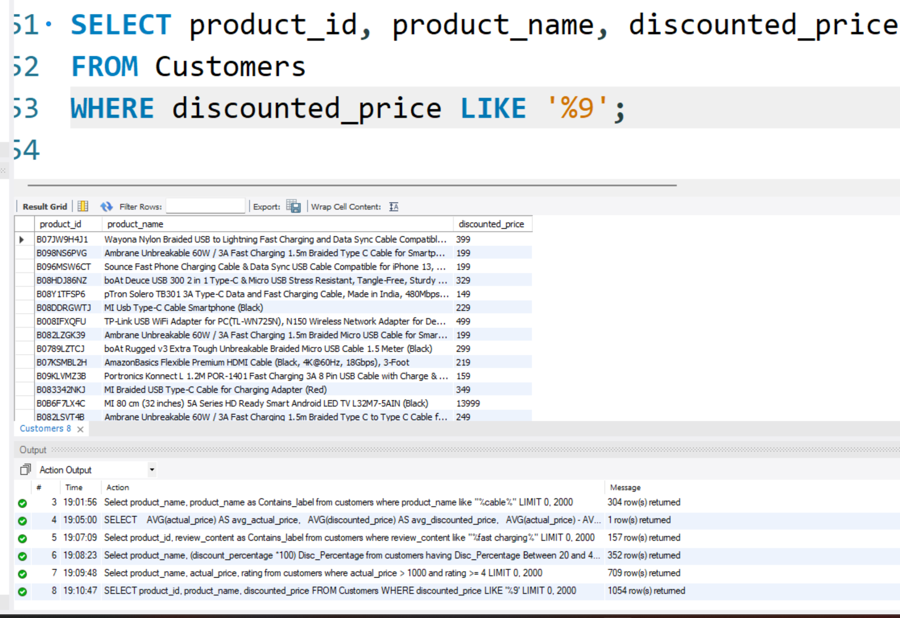
Q8: Products Ending with Price 9
Find products where the discounted price ends with a 9.
SELECT product_id, product_name,
discounted_price
FROM Customers
WHERE discounted_price LIKE '%9';

Slide 11
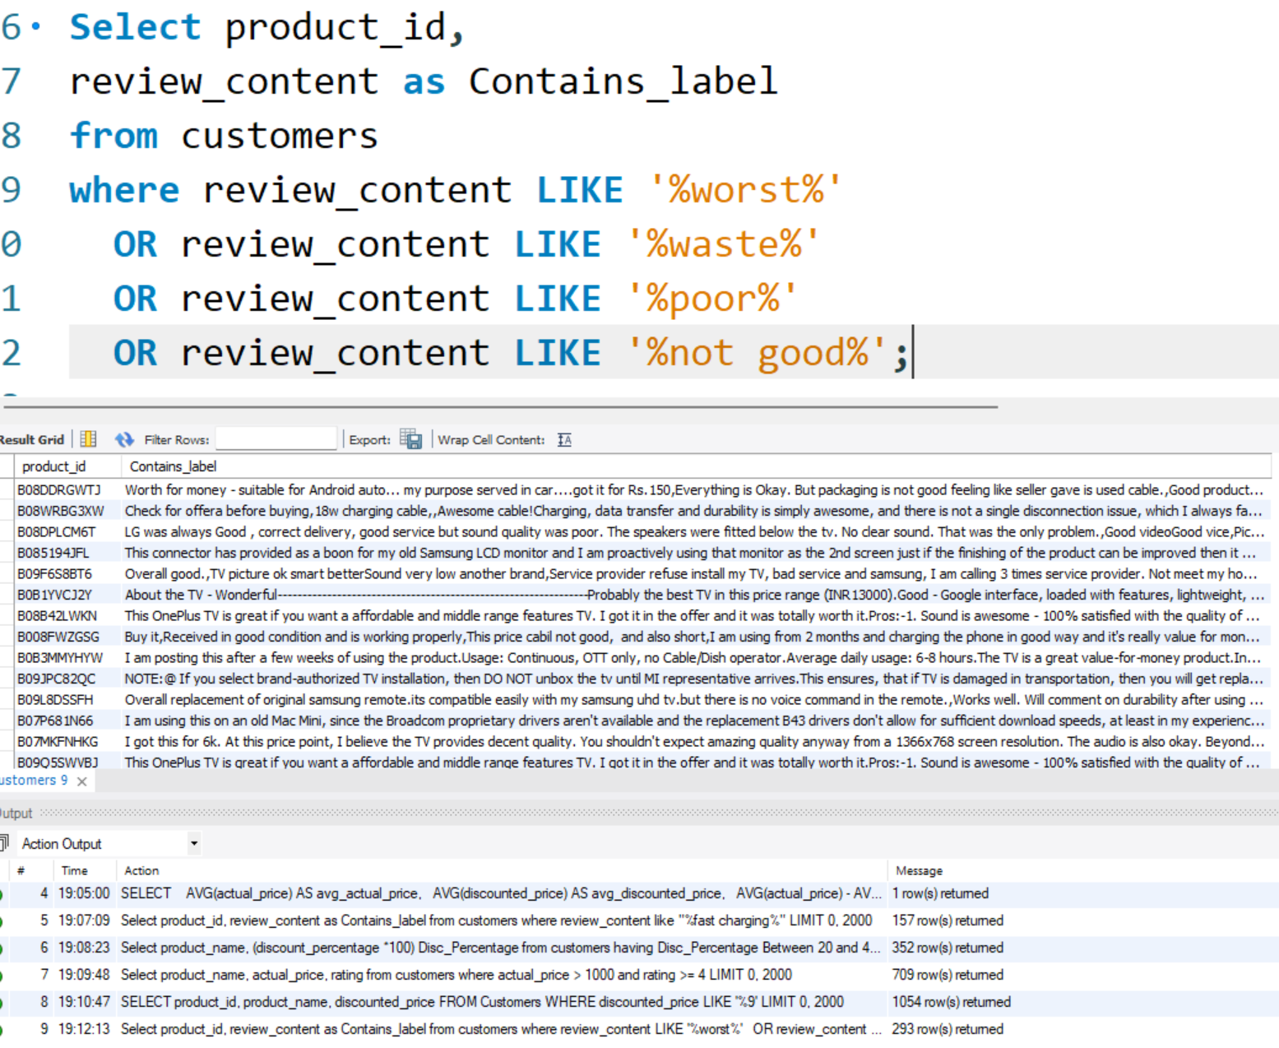
Q9: Negative Reviews Detection
Display reviews containing words like worst, waste, poor, or not good.
SELECT product_id, review_content
FROM customers
WHERE review_content LIKE '%worst%'
OR review_content LIKE '%waste%'
OR review_content LIKE '%poor%'
OR review_content LIKE '%not good%';

Slide 12
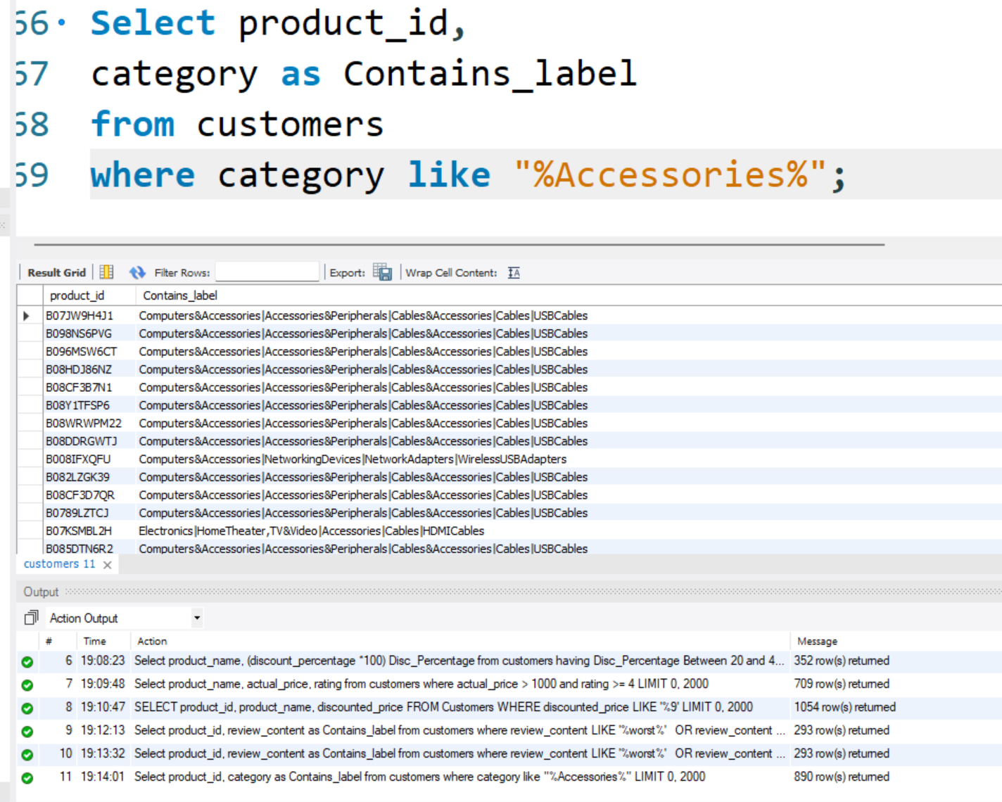
Q10: Accessory Products
List all products where the category includes "Accessories."
SELECT product_id,
category as Contains_label
FROM customers
WHERE category LIKE '%Accessories%';

Slide 13
Query Summary
10 Essential Queries covering product filtering and analysis
Uses WHERE, HAVING, LIKE, BETWEEN, AND, OR clauses
Focuses on Amazon Sales Database patterns
Practical examples for data filtering and analysis

